Slide 1
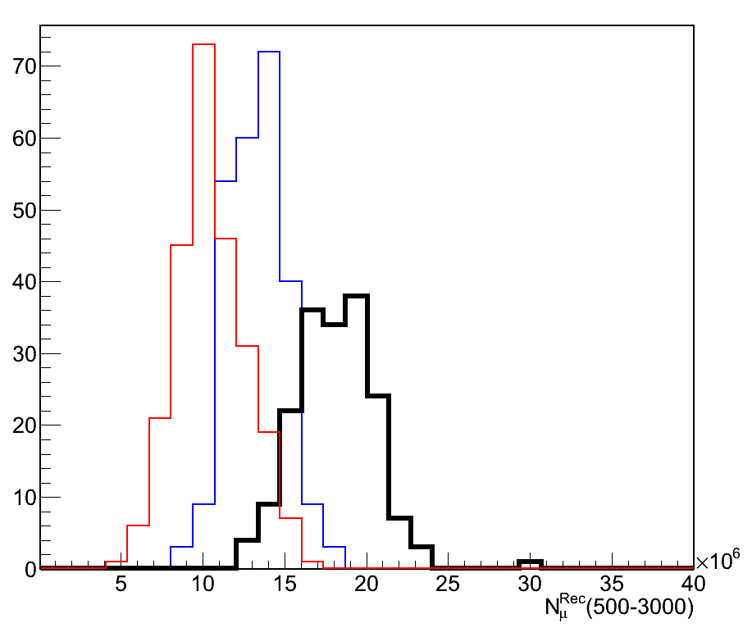
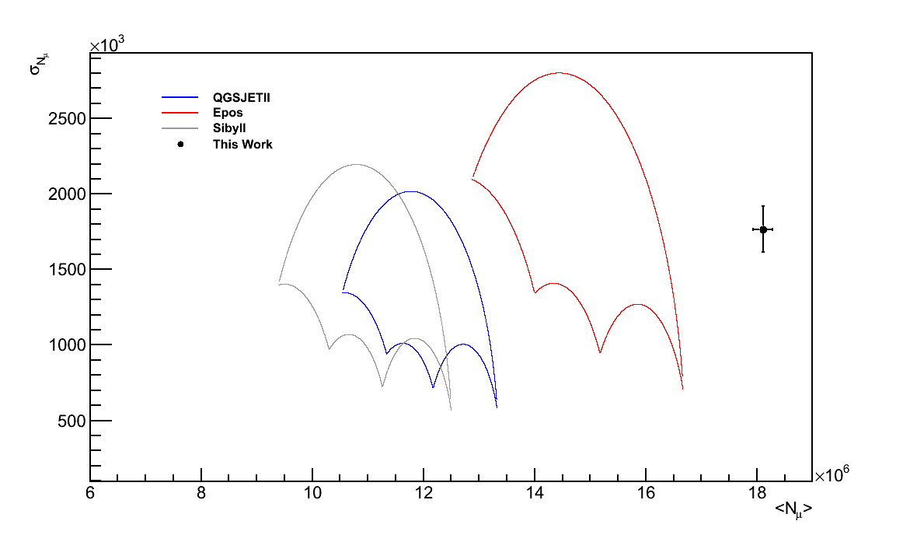
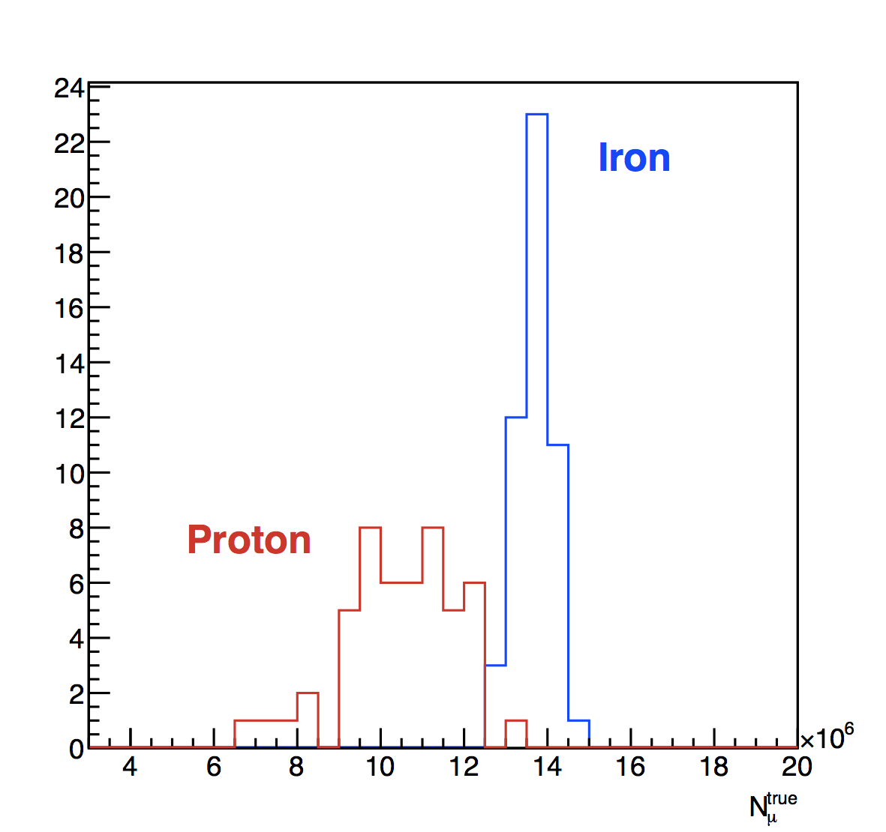
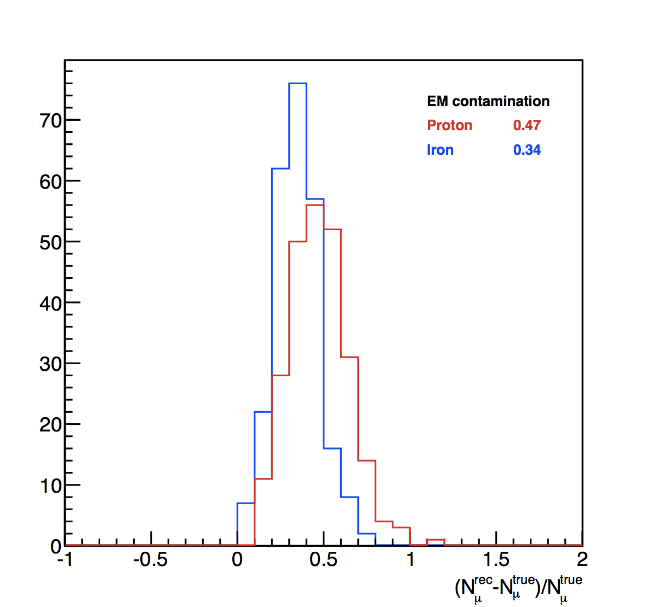
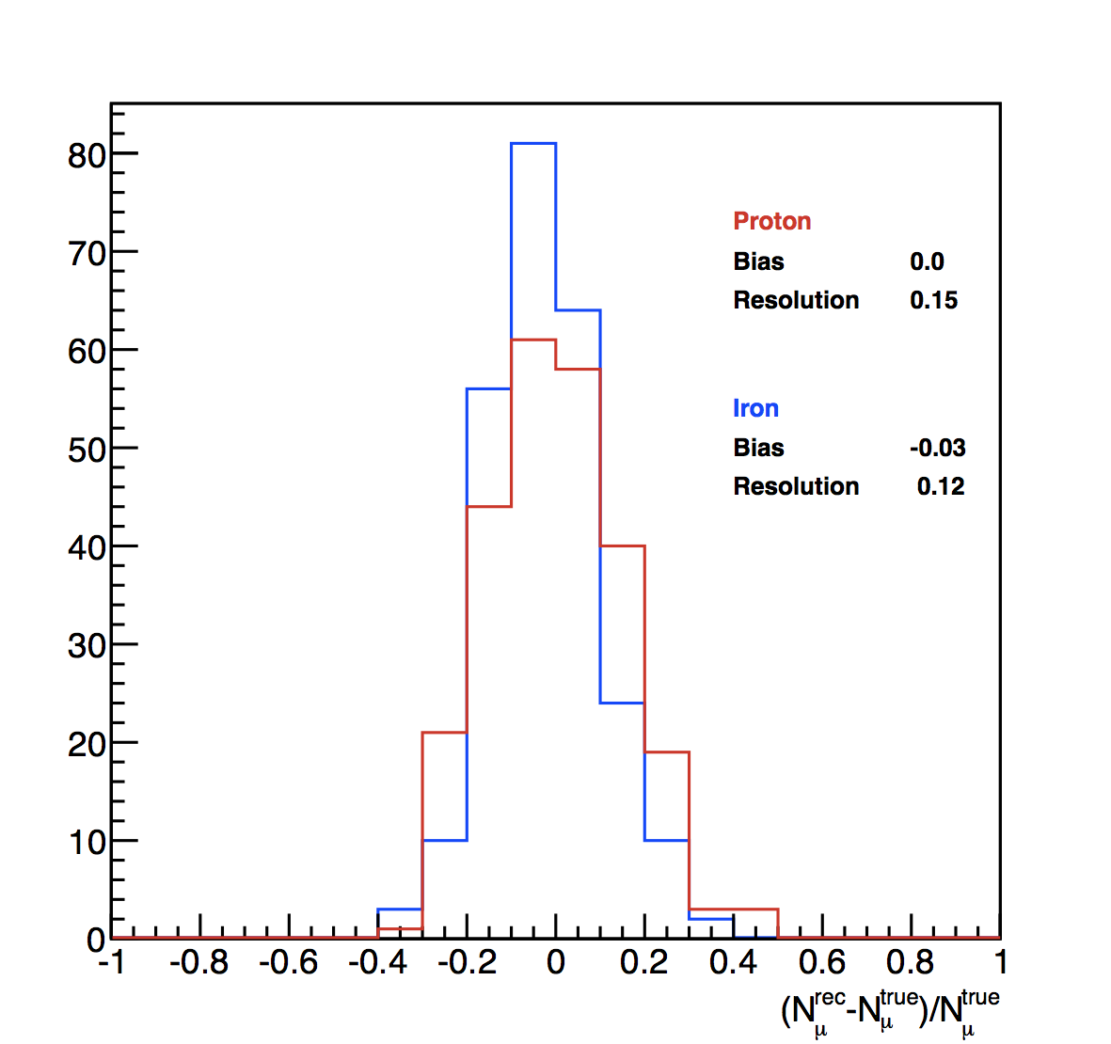
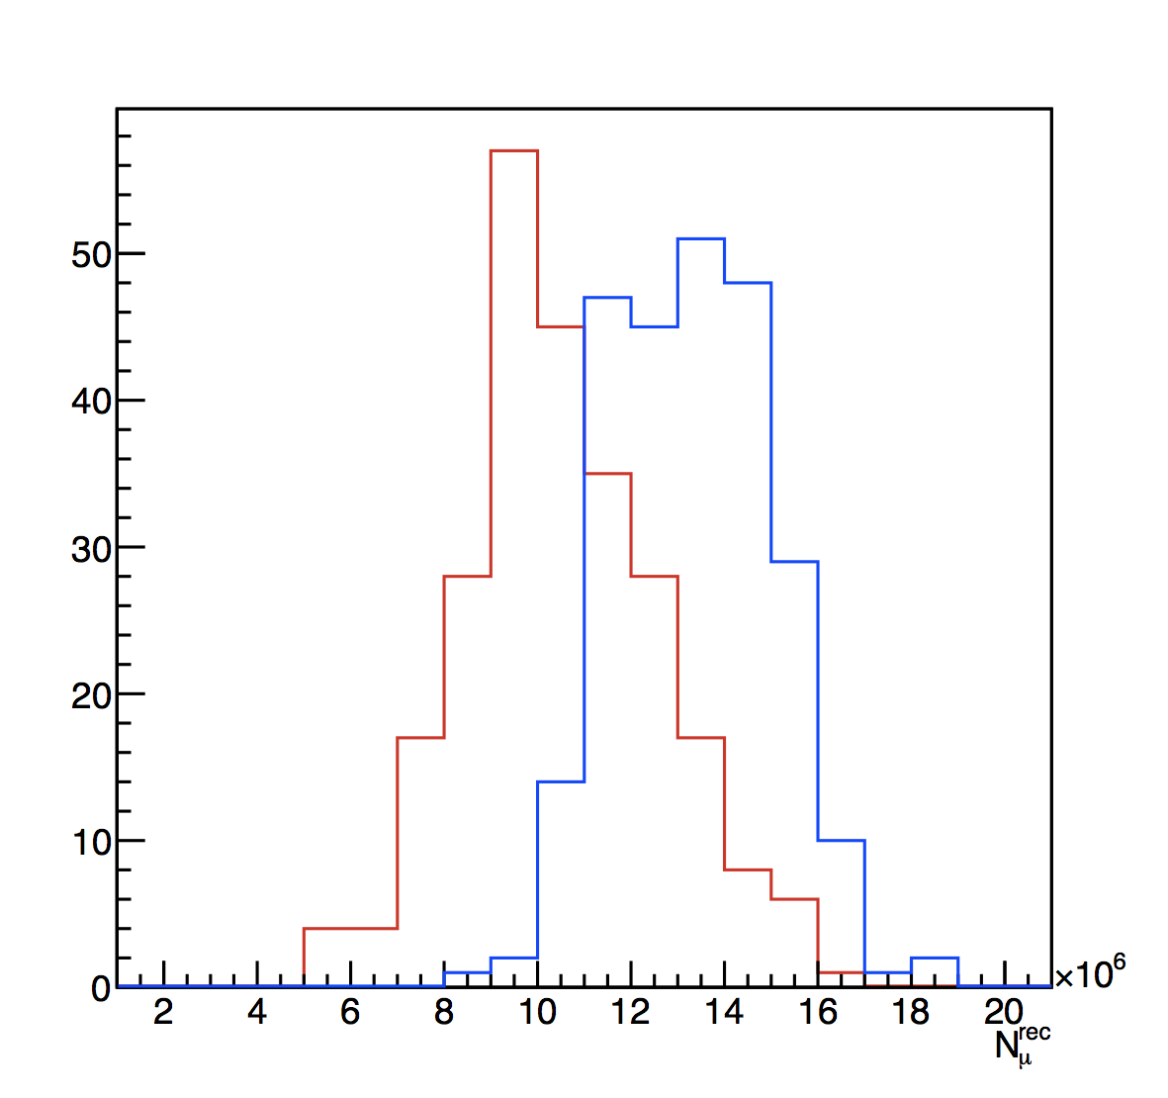


_{μ}
Measurement of the Number of Muons in Inclined Showers at the Pierre Auger Observatory
μ
Micael Oliveira^{a,b} (jmicael@lip.pt), Lorenzo Cazon^{b}, Ruben Conceição^{b}, Mário Pimenta^{a,b}
ª Departamento de Física, Instituto Superior Técnico, Universidade Técnica de Lisboa, Portugal
^{b} Laboratório de Instrumentaçõo e Física Experimental de Partículas, Lisboa, Portugal
Introduction
Results from the Reconstruction method
At the Pierre Auger Observatory physicists study the most energetic particles ever detected by mankind. The center-of-mass energies involved in the interactions of these particles can be of the order of 100 TeV.
The origin, composition and acceleration mechanisms of Ultra High Energy Cosmic Rays remain challenging physics questions.
The exploration towards answering these questions involves the understanding of the electromagnetic, muon and light components of extensive air showers (EAS).
The main focus of this work: We propose a new way of measuring the number of muons in EAS when these reach the ground from the signal in the Surface Detector. We work with inclined showers θ=60° and primary energies of 10¹⁹ eV.
Applying the new method to the Auger data on can recover the distributions. Quality Cuts: log E [18.95 – 19.05]; θ [58.5 – 61.5]; 178 Events passed the cuts.
N_{μ} from Surface Detector Signal
We developed a method to recover the number of muons from the lateral distribution function. The total signal on the ground is:
Distribution for the number of muons obtained with the reconstruction method (data is in black).
The electromagnetic component is minimized in inclined showers.
The total signal detected on the ground is dominated by the muonic component.
Muons give signals proportional to their tracks.
There are more muons in the data than predicted by any primary with the hadronic interaction model QGSJet-II.
The realtion between the number of muons and the signal is:
Another interesting feature obtained with this model can be seen in the Umbrella plots. These plots depict the phase space considering a proton to iron transition and the transitions of all the intermediate elements.
The following distributions depict the results from simulations and the main properties of the method developed. In blue you have the distributions for iron initiated showers and the same in red for proton.
The hadronic interaction models available cannot correctly explain the Auger data.
Discussion and Conclusions
New original method to determine the number of muons from the signal in the SD stations.
The muonic component of EAS cannot be correctly described with the current hadronic interaction models.
The study of the momenta of the muon distributions can provide new insight into EAS physics.
_{μ}
1st IDPASC PhD Students Workshop
12 – 13 October 2012
Coimbra - Portugal

